Slide 1



SALES DATA PREDICTION: UNVEILING FUTURE REVENUE TRENDS
Presented By:
N. Kiran Kumar
192224079
P.S. Rohit
192224082

Slide 2


Introduction to Sales Data Prediction
Welcome to our presentation on analyzing historical sales data to unlock valuable insights and drive informed decision-making. In today's competitive business landscape, understanding past performance is essential for shaping future strategies and achieving sustainable growth.
By delving into historical sales data, we can uncover patterns, trends, and opportunities that empower us to optimize our sales strategies, enhance customer experiences, and maximize revenue potential.
Throughout this presentation, we will explore the importance of historical sales data analysis, the methodologies involved, and the actionable insights it can provide for businesses across various industries. From data collection and cleaning to advanced analytics and forecasting, each step in the process plays a crucial role in extracting meaningful insights from the vast amount of sales data at our disposal.

Slide 3

Importance of Predicting Future Revenue Trends
Strategic Decision Making
Risk Mitigation
Competitive Advantage
Predicting future revenue trends allows businesses to make informed decisions regarding investments, expansions, and resource allocation.
Anticipating revenue trends helps in identifying potential financial risks and taking proactive measures to mitigate them.
Accurate revenue prediction gives companies an edge in the market by enabling them to plan and execute strategies more effectively than their competitors.

Slide 4

Methodology for Sales
Data Prediction
1
Data Collection
2
Analysis Techniques
Collecting comprehensive sales data from various sources, including CRM systems and market databases.
Utilizing statistical and machine learning techniques to identify patterns and predict future revenue trends.
3
Validation and Testing
Thoroughly testing predictive models and validating the accuracy of sales data predictions.

Slide 5
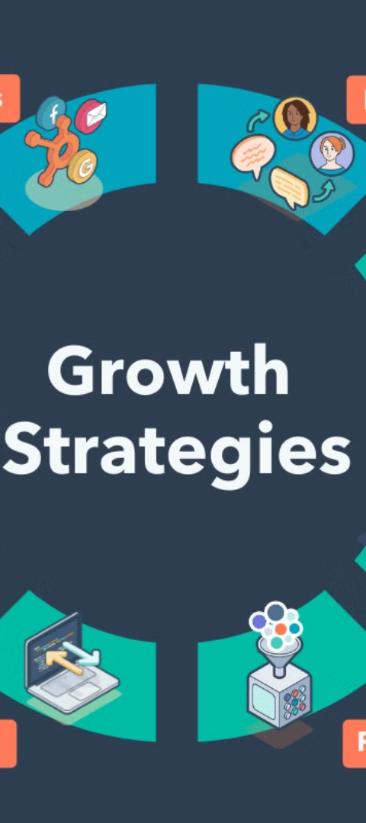
Key Factors Influencing Revenue Trends
1
Market Demand
Understanding customer needs and market trends that drive purchasing behavior.
2
Macroeconomic Factors
Considering economic indicators like GDP, inflation, and interest rates that impact consumer spending.
3
Competitive Landscape
Analyzing industry competition and other external factors influencing revenue trends.

Slide 6
Analysis of Historical Sales Data
Data Collection: Gather comprehensive sales data spanning a significant period, including sales figures, product/service categories, customer demographics, geographical locations, and sales channels.
Data Cleaning and Preprocessing: Cleanse the data to remove errors, duplicates, and inconsistencies. Normalize the data format and handle missing values appropriately to ensure accuracy.
Descriptive Analysis: Conduct descriptive analysis to summarize key statistics and insights from the historical sales data. This includes metrics such as total sales revenue, average order value, sales growth rates over time, and distribution of sales across different products or regions.
Trend Identification: Use visualization techniques such as line charts, bar graphs, and heatmaps to identify trends and patterns in the sales data. Look for recurring seasonal trends, sales peaks or troughs, and correlations between variables.
Segmentation Analysis: Segment the sales data based on various factors such as customer segments, product categories, sales channels, and geographic regions. Analyze each segment's performance individually to uncover specific insights and opportunities for improvement.
Customer Behavior Analysis: Explore customer purchasing behavior by analyzing metrics such as repeat purchase rates, customer lifetime value, and purchase frequency. Identify high-value customers and understand their preferences and buying habits to tailor marketing strategies accordingly.

Slide 7

Analysis of Historical Sales Data
Market and Competitor Analysis: Analyze market trends and competitive landscape to contextualize the sales data. Understand how external factors such as economic conditions, industry trends, and competitor actions influence sales performance.
Forecasting and Predictive Modeling: Use historical sales data to develop predictive models for forecasting future sales trends. Employ statistical techniques such as time series analysis, regression analysis, and machine learning algorithms to make accurate predictions based on historical patterns.
Root Cause Analysis: Investigate the underlying factors contributing to fluctuations or anomalies in the sales data. Identify potential causes such as changes in pricing, marketing campaigns, product launches, or external events, and assess their impact on sales performance.
Continuous Monitoring and Iteration: Sales data analysis is an ongoing process. Continuously monitor sales performance, update models and strategies based on new data, and iterate on insights to drive continuous improvement and adapt to evolving market dynamics.

Slide 8
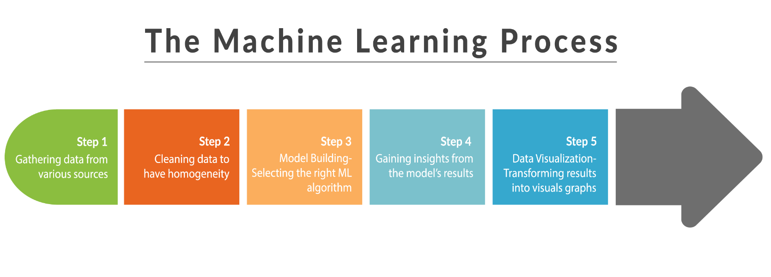

Predictive Models
Used for Revenue
Forecasting
Machine Learning Models
Time Series Forecasting
Utilizing algorithms to analyze historical sales data and predict future revenue trends.
Utilizing historical time-stamped data to create predictions based on past patterns and trends.
Regression Analysis
Using statistical techniques to identify relationships between variables and predict future revenues.

Slide 9




Case Studies on Successful Revenue Predictions
Data-Driven Marketing Strategies
Optimized Inventory Management
Dynamic Pricing Strategies
Using predicted revenue trends to tailor pricing strategies in response to changing market conditions.
Implementing targeted marketing campaigns based on accurate revenue predictions.
Streamlining inventory levels based on predicted sales patterns to reduce stock-outs and overstock situations.

Slide 10
AI
FUTURE SCOPE
Advanced Analytics and AI Integration: Utilize AI algorithms for quick analysis and pattern recognition in sales data.
Predictive Modeling and Forecasting: Develop accurate predictive models using machine learning to forecast future revenue trends.
Real-Time Data Analysis: Implement technologies for capturing and analyzing sales data as it occurs, enabling swift decision-making.
Integration of Multiple Data Sources: Combine data from various sources like CRM, POS, and social media for comprehensive
insights.
Personalized Sales Strategies: Tailor sales approaches based on customer data, improving conversion rates and revenue.
Blockchain for Data Security: Employ blockchain technology to enhance data security and integrity in sales data management.
Emphasis on Data Privacy and Compliance: Ensure compliance with data protection regulations and prioritize customer privacy
in sales data practices.
Collaborative Forecasting: Foster collaboration between departments for more accurate revenue forecasts, integrating insights
from sales, marketing, finance, and operations.

Slide 11





Conclusion and Next Steps
Successful Forecasts
Strategic Planning
Continuous Improvement
Collaborative Efforts
Accurate revenue predictions lead to successful business outcomes and strategic decision-making.
Using revenue predictions to strategically plan for future business growth and expansion.
Staying ahead through continuous innovation and adaptation based on predictive insights.
Utilizing revenue projections to drive collaborative efforts and achieve shared business goals.

Slide 12

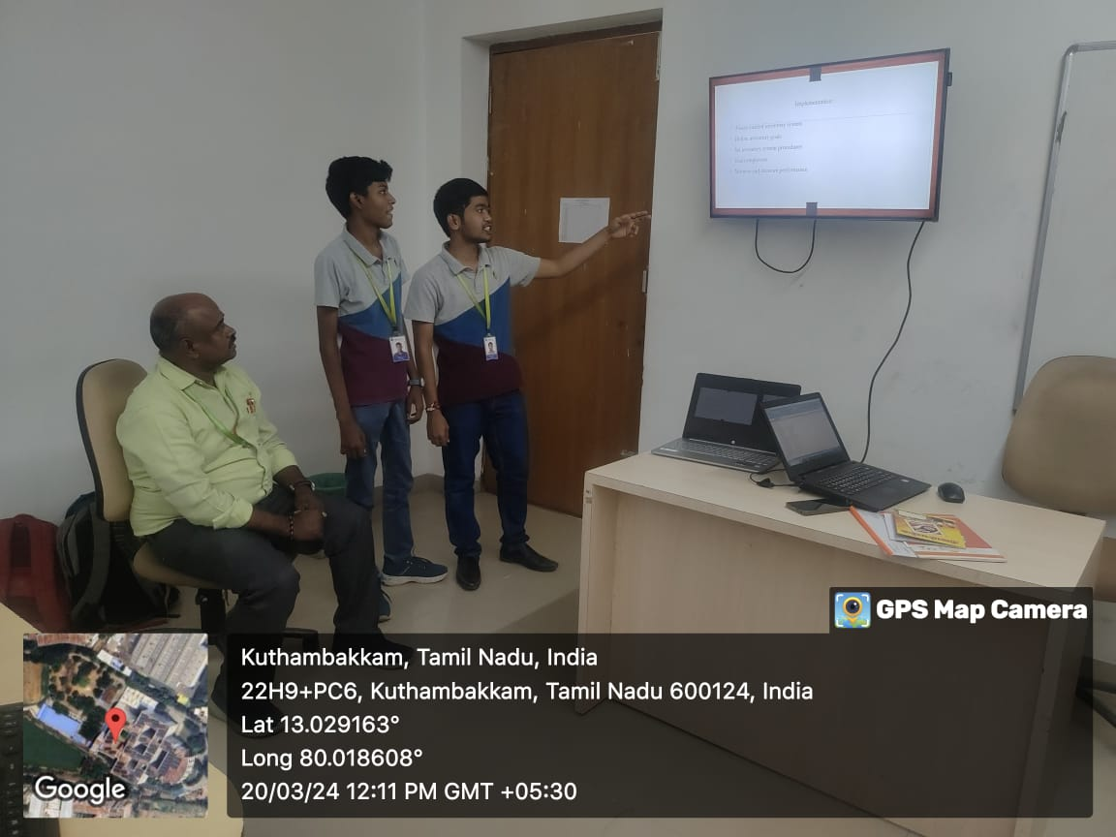


Slide 13


